Slide 1
Case Study: Kate’s Blog
Kate: Maintains a popular “life on campus” blog
Jerry: Another student; active in Whig Party
At private birthday party, someone gives Jerry a Tory Party T-shirt as a gag, and Jerry puts it on
Kate uses cell phone to take picture of Jerry when he isn’t looking, posts it on her blog
Story read by many people on and off campus
Jerry confronts Kate and demands she remove photo; she complies, and they remain friends
Kate’s blog and Jerry both become more popular
1-1

Slide 2
Kantian Analysis
Kate uploaded Jerry’s photo to her blog without asking his permission
She treated him as a means to her end of increasing the readership of her Web site
Her action was wrong
1-<number>

Slide 3
Social Contract Theory Analysis
Birthday party held in apartment of one of Jerry’s friends
Jerry had a reasonable expectation of privacy
Kate violated Jerry’s right to privacy
Kate’s action was wrong
1-<number>

Slide 4
Act Utilitarian Analysis
Benefits
  Popularity of Kate’s blog increased (definitely)
  Jerry become more popular on campus (definitely)
Harms
  Jerry’s anger at Kate (only temporary)
  Photo could discredit Jerry at some point in future (unlikely)
Benefits greater than harms, so Kate did a good thing
1-<number>

Slide 5
Rule Utilitarian Analysis
What if everyone were constantly taking photos of people they encountered and posting them?
Positive consequences
  People would have more opportunities to keep up with what their friends are doing
  People might be more reluctant to engage in illegal activities
Negative consequences
  People would become more self-conscious
  Some relationships would be harmed
Negative consequences more weighty than positive consequences, so Kate’s action was bad
1-<number>

Slide 6
Virtue Ethics Analysis
True friends trust each other and seek each other’s good
Reciprocity and equality are fundamental elements of friendship
Lack of reciprocity: Kate took something from Jerry without giving him anything in return
Lack of equality: She put her own interest above that of Jerry
Kate’s actions did not seem to be characteristic of a good friend
1-<number>

Slide 7
Summary
Four out of five analyses: Wrong for Kate to post the photo without asking Jerry’s permission
Kate figured it would be better to beg for forgiveness than ask for permission, but she cut Jerry out of a decision that affected both of them, and that’s no way to treat a friend
Kate should have tried to get Jerry’s consent
1-<number>

Slide 8
3.7 Children and Inappropriate Content
1-<number>

Slide 9
Web Filters
Web filter: Software that prevents display of certain Web pages
  May be installed on an individual PC
  ISP may provide service for customers
Methodologies
  Maintain “black list” of objectionable sites
  Examine content for objectionable words/phrases
1-<number>

Slide 10
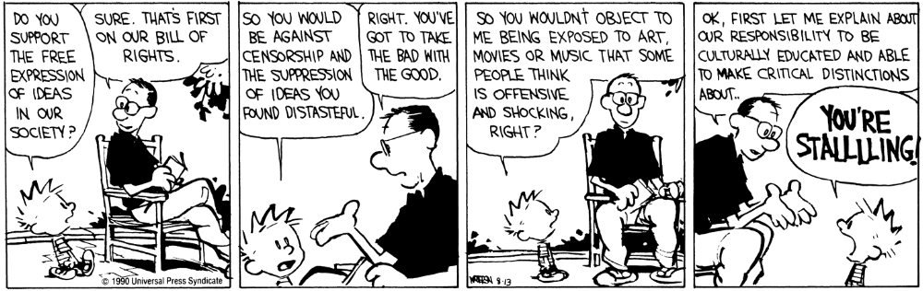
Calvin and Hobbes, 1990 / © Universal Press Syndicate
1-<number>

Slide 11
Child Internet Protection Act
Libraries receiving federal networking funds must filter pages containing obscenity or child pornography
U.S. Supreme Court ruled CIPA did not violate 1st Amendment guarantees
(6-3 decision in June 2003)
1-<number>

Slide 12
Ethical Evaluations of CIPA
Kantian evaluation: CIPA is wrong
Act utilitarian evaluation: depends on how benefits and harms are weighed
Social contract theory: freedom of conscience should be given precedence
1-<number>

Slide 13
Sexting
Definition: sexually suggestive text messages or emails with nude or nearly nude photographs
In a 2009 survey, 9% of U.S. teenagers admitted to sending a sext, 17% admitted to receiving a sext
Case of Jesse Logan
Case of Phillip Alpert
Case of Ting-Yi Oei
1-<number>

Slide 14
3.8 Breaking Trust
1-<number>

Slide 15
Identity Theft (1/2)
Identity theft: When a person uses another person’s electronic identity
Leading form of identity theft is credit card fraud
Financial institutions contribute to problem by making it easy to open new accounts
About 8 million cases of identity theft in U.S. in 2010
Consumer’s liability for credit card losses limited to $50
1-<number>

Slide 16
Identity Theft (2/2)
Nearly half of cases from lost credit card, checkbook, etc.
In 20% of cases, credit card number stolen at time of making purchase (skimmers)
About 1 million cases of identity theft annually in United States from online activities
Phishing: Use of email to attempt to deceive people into revealing personal information
Identity theft a federal crime, but only 1 in 700 cases results in an arrest
1-<number>

Slide 17
Chat-Room Predators
Chat room: Supports real-time discussions among many people connected to network
Instant messaging and chat rooms replacing telephone for many people
Some pedophiles meeting children through chat rooms
Police countering with “sting” operations
1-<number>

Slide 18
Ethical Evaluations of “Stings”
Utilitarian evaluation
Kantian evaluation
Social contract theory evaluation
1-<number>

Slide 19
False Information
Quality of Web-based information varies widely
Other media also have information of varying quality
  The New York Times v. The National Enquirer
  60 Minutes v. Conspiracy Theory
Google attempts to reward quality
  Ranking uses “voting” algorithm
  If many links point to a page, Google search engine ranks that page higher
1-<number>

Slide 20
Cyberbullying
Cyberbullying: Use of the Internet or phone system to inflict psychological harm
In a 2009 survey, 10% admitted to cyberbullying, and 19% said they had been cyberbullied
Case of Ghyslain Raza
Case of Megan Meier
Megan Meier Cyberbullying Prevention Act
1-<number>

Slide 21
3.9 Internet Addiction
1-<number>

Slide 22
Is Internet Addiction Real?
Some liken compulsive computer use to pathological gambling
Traditional definition of addiction:
  Compulsive use of harmful substance or drug
  Knowledge of its long-term harm
Some people spend 40-80 hours/week on the Internet, with individual sessions lasting up to 20 hours
1-<number>

Slide 23
Is Internet Addiction Real?
Kimberly Young created test for Internet addiction
  Sample question: “Have you repeatedly made unsuccessful efforts to control, cut back, or stop Internet use?”
  Patients who answer “yes” to at least 5 of 8 questions may be addicted
Others disagree, noting
  Computer use is generally considered a positive activity
  Excessive use does not lead to criminal activity
  More accurate to call excessive use a compulsion
1-<number>

Slide 24
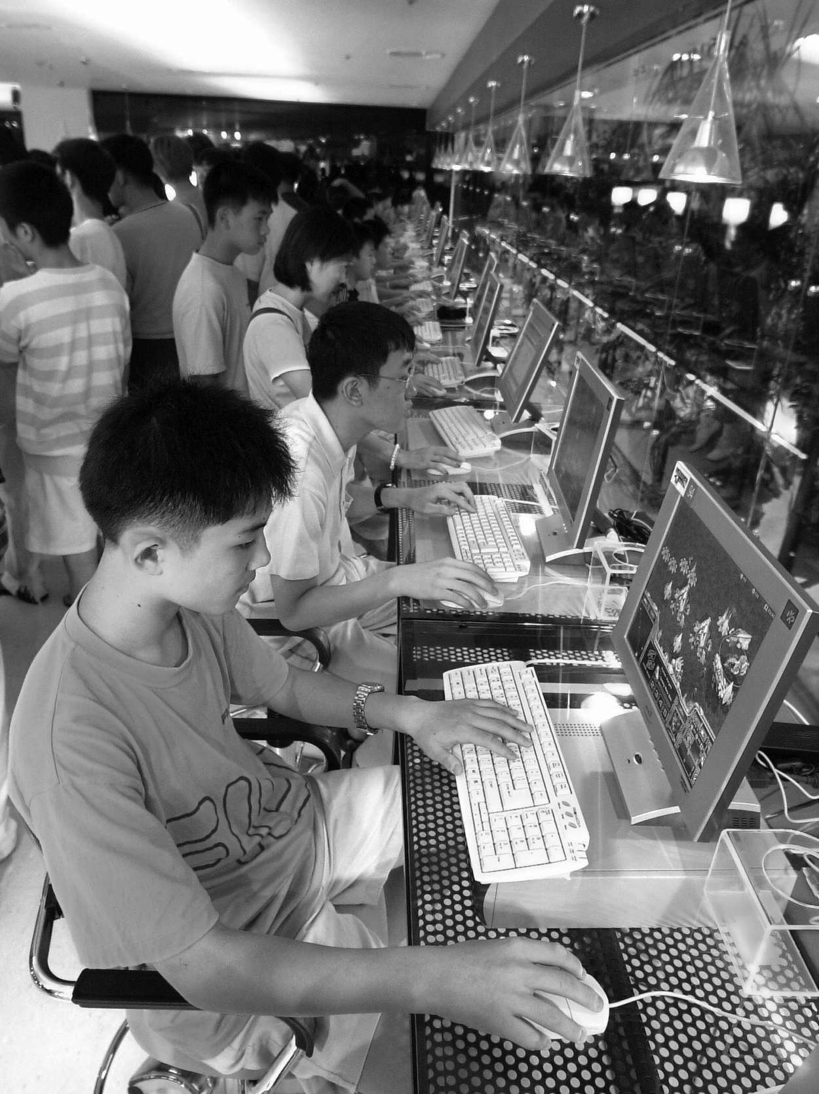
South Koreans in a PC Bang
Kim-Jae Hwan
1-<number>

Slide 25
Contributing Factors
Social factors
  Peer groups
Situational factors
  Stress
  Lack of social support and intimacy
  Limited opportunities for productive activity
Individual factors
  Tendency to pursue activities to excess
  Lack of achievement
  Fear of failure
1-<number>

Slide 26
Ethical Evaluation
Enlightenment view
  Individuals can and should govern their lives
  People are responsible for their choices
Jeffrey Reiman’s view
  Addict’s behavior makes sense if addict has no hope for a better future
  Society bears responsibility for putting people in hopeless situations
1-<number>

